Slide 1
Large Language Model Applications To Grading Open Response Mathematics Questions
Russell Thompson

Slide 2
Introduction
Natural Language Models have not penetrated the field of education beyond simple translation and editing tasks.
One obvious area that these models could be eminently useful is in grading open response questions.
With the emergence of Large Language Models like GPT3, OPT, and BLOOM, it is possible that the model sophistication has gotten to the point where they can assist in the evaluation of these open response problems

Slide 3
Background
Grading open response questions on intelligent learning platforms is still a largely manual job.
Many efforts have been made to automate the grading of open response questions.
using them to encode responses into a response state, and use these encodings to either perform clustering or to train classifiers.
Though these models are decent, their practical utility is to simply provide suggestions to teachers rather than be reliable aids.

Slide 4
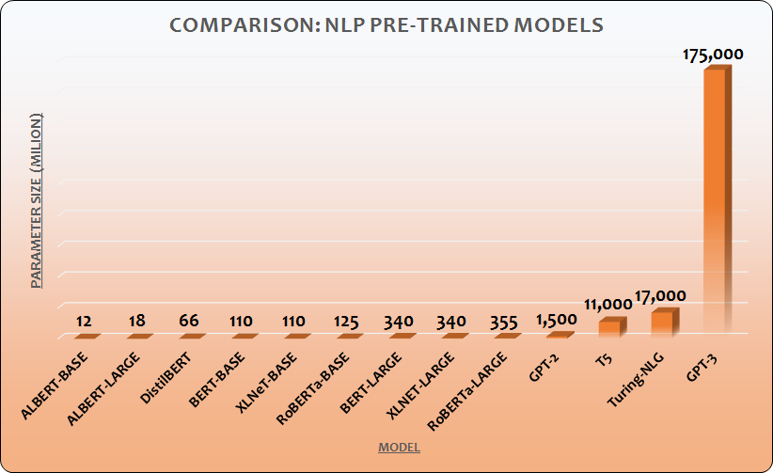
Background
The development of Large Language Models (LLMs) such as GPT3 has revolutionized what is possible in natural language processing.
The datasets they are trained on include the entirety of wikipedia, all scanned literature, and entirety of reddit, just to name a few.

Slide 5
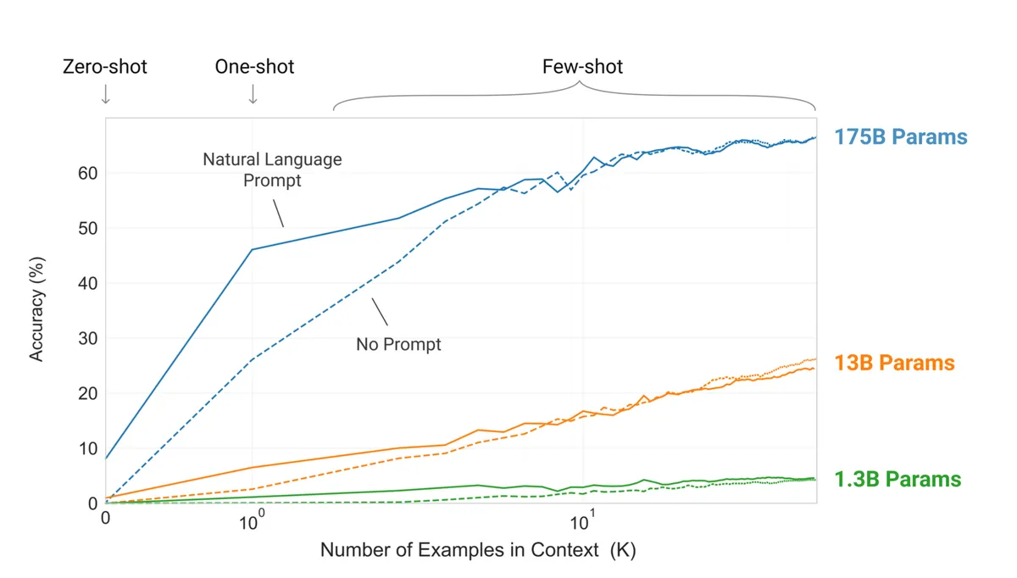
Background
These models require months to train and millions of dollars to fund, but once they are trained they can be applied in a diverse range of situations
This project proposes to use many of the same methods pioneered by GPT3, except using the BLOOM model in its place.

Slide 6
Background
Few-shot learning is a unique capability of Large LAnguage Models
Allows models to leverage knowledge on training data to accurately tackle new tasks
These tasks can include question answering, classification, summarization, etc…
Prompt structure is immensely important in how well these models perform on these few-shot tasks.

Slide 7

Dataset
This project will be built on the Quick Comments Open Response dataset from the ASSISTments intelligent learning platform.
A subset of these problems are provided in the github, as these have been screened for Personally Identifiable Information. Access to the whole dataset requires written consent.

Slide 8
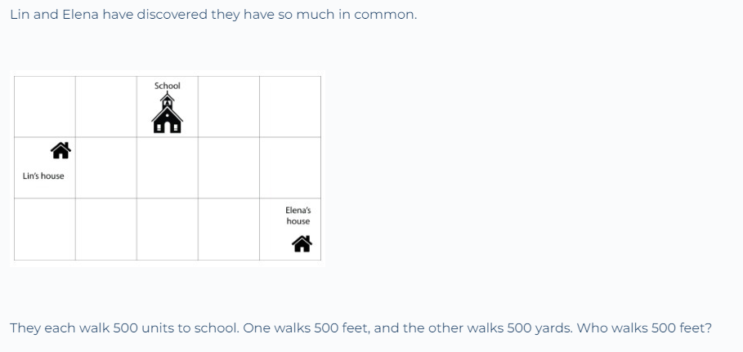
Dataset
The dataset consists of 150,477 total student responses from 27,199 unique students to 2,076 unique problems graded by 970 unique teachers.
Problems were then filtered to remove those that contain an image in the problem or ask for an image as an answer.
NLP models cannot process images

Slide 9


Methods
Training Environments
Google colaboratory
Allows for VM access to a GPU
The WPI High Performance Cluster (HPC) will be used to make evaluating the model possible. The HPC has 64 gpus, 1300 cpus, and 2.3 TBs or RAM, all available for use by researchers.

Slide 10

Methods
Hugging Face is an NLP library which stores openly accessible state of the art NLP models.
Hugging face also allows for the easy implementation of the models through its pipeline and trainer functions.

Slide 11
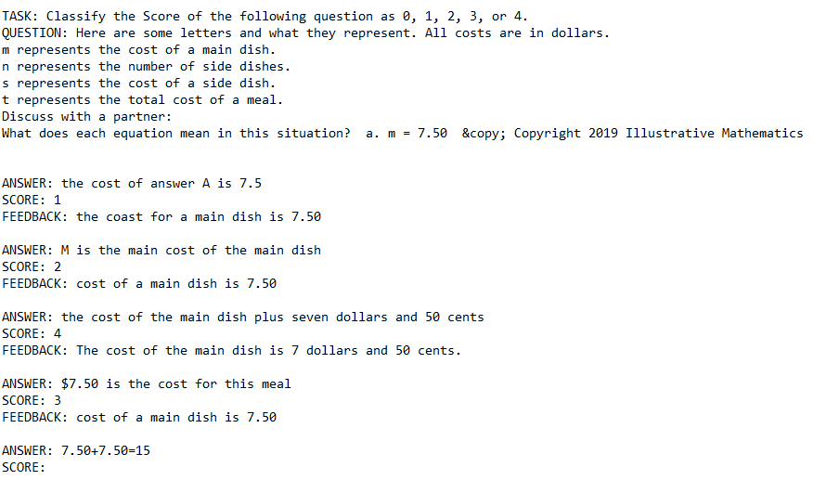
Prompt Construction
Prompts were constructed either in ascending order, descending order or randomly.
Each prompt could vary in the number of examples provided.
This was a variable that was tested.
Multiple prompts were also created for each of the examples
This allows us to average the scores across multiple examples to see how performance is impacted.

Slide 12
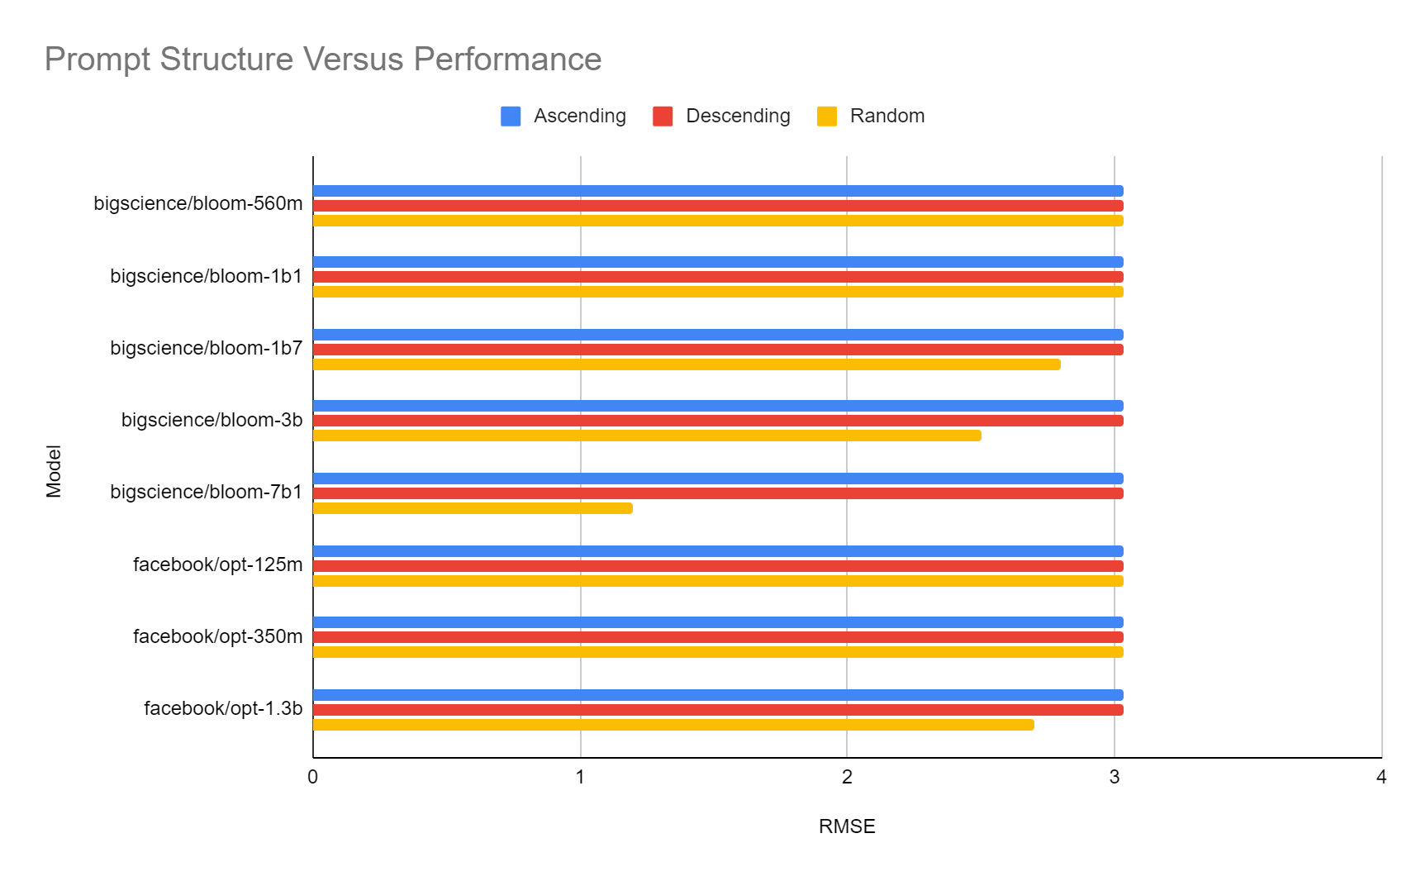
Results
Simply: Ascending and Descending orders are useless.
Model perceives a pattern and subsequently simply follows the pattern.
Random Example order yielded promising, varied results.

Slide 13
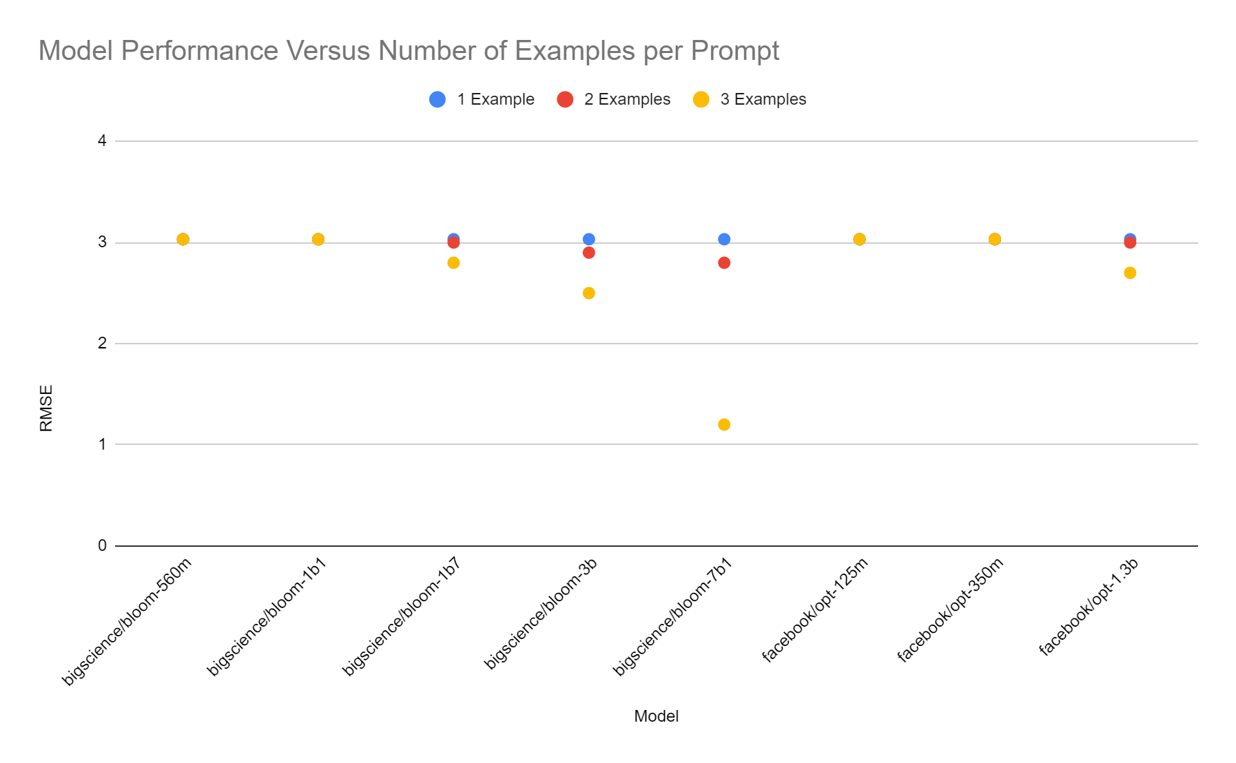
Results
Simple trend: the more examples the better.
Limited trying further sizes, as the mx input size of the smaller models was reached.
Larger models could taker larger prompts.

Slide 14
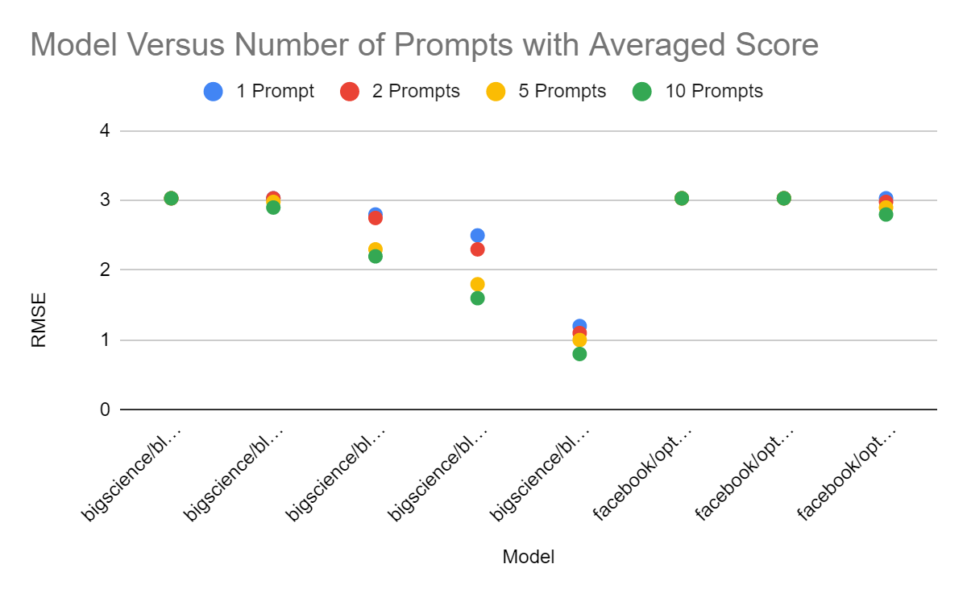
Results
The more prompt examples the better, to a degree.
Larger models benefited more from more prompts.
All prompts were constructed with three examples, as this was discovered to be best from previous.

Slide 15
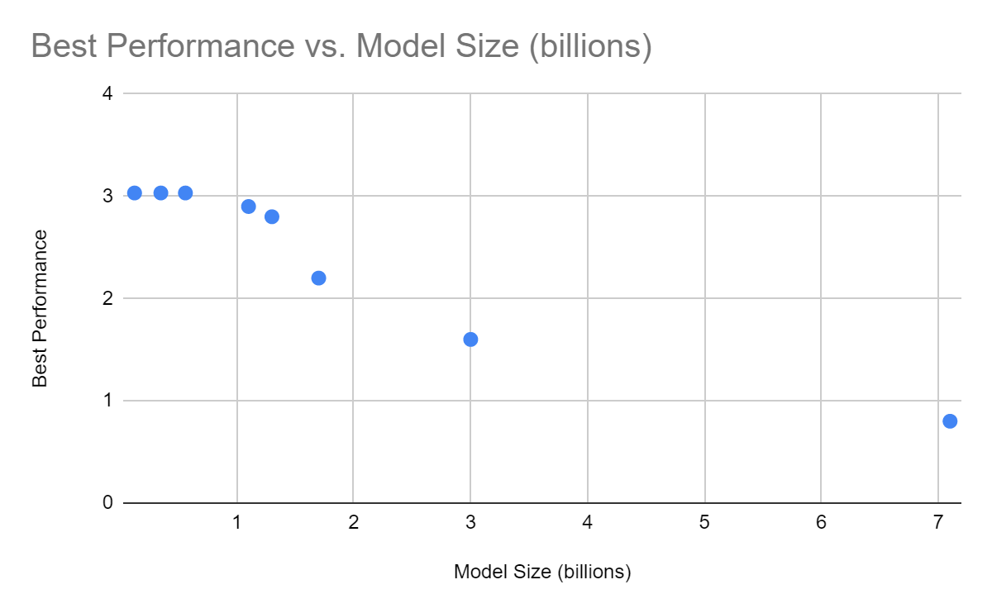
Results
Size was the biggest determining factor in model performance.
Smaller models were incapable of generalized few shot learning
Larger models performed much better, though there appears to be a plateau

Slide 16
Discussion
The findings of this experiment are consistent with the best practices in the Large Language Modeling field.
More examples is better
Averaging over more prompts is better
Bigger models are better.
Disappointed by ultimate accuracy.
RMSE of 0.8 means that the predicted score of the model was almost a full grade off from what the teacher actually scored the answer.

Slide 17
Conclusion
The findings of this experiment are consistent with the best practices in the Large Language Modeling field.
More examples is better
Averaging over more prompts is better
Bigger models are better.
Disappointed by ultimate accuracy.
RMSE of 0.8 means that the predicted score of the model was almost a full grade off from what the teacher actually scored the answer.
More computational resources would allow for even better accuracy, as the models could be specially trained for this task.

Slide 18
Limitations
Time
Modeling takes a lot of time, especially for models of this size.
Using shared resources like WPI’s HPC means waiting your turn
Constructing these datasets
No access to best in the field
Google and OpenAI gate keep their best models
Open Source Models allow us to explore methods and see trends, but hardly ever actually achieve the best results.

Slide 19
Future Work
Fine tuning the models
This will take even more time and computational resources
Include chain prompting
This is where the LLM is prompted with many similar questions in a row, to aid its final classification task.
Fine Tuning large model on math and math educational resources as a whole
Consistently it has been found in the field that more training models on more background data in a field increases performance.

Slide 20
Resources
Hugging Face: https://huggingface.co/
https://www.wpi.edu/offices/vice-provost-research/academic-research-computing/high-performance-computing
https://colab.research.google.com/
Github Link: https://github.com/rjthompson22/BigDataAnalyticsFinal

